Slide 1
Program Control: Selection
Subject : COMP6047
ALGORITHM AND PROGRAMMING
Year : 2019

Slide 2
Learning Outcomes
At the end of this session, student will be able to:
Demonstrate usage of selection control in C programming language (LO2 & LO3)

Slide 3
Sub Topics
Program Control – Selection:
Selection Definition
If
If-Else
Nested If
Program Examples Using If
Switch-Case
?: Operator
Error Type
Program Examples Using Switch-Case
Program Examples Using ?:
Exercise

Slide 4
Selection Definition
In an algorithm implementation, an instruction or block of instructions may be executed (or not) with certain predetermined condition
Syntax:
if
if-else
switch-case

Slide 5
Selection: IF
Syntax :
if (boolean expression) statement;
or
if (boolean expression) {
statement1;
statement2; Block of statements
……
}
If boolean expression resulting in True, then a statement or some statements will be executed.

Slide 6
Selection: IF
Flow Chart of IF Statement
false
true
condition
statements

Slide 7
Selection: IF-ELSE
Syntax :
if (boolean expression) statement1;
else statement2;
or
if (boolean expression){
statement1;
statement2; Block statement1
……
}
else {
statement3;
statement4; Block statement2
…
}
If boolean expression resulting in TRUE, then statement1 or block statement1 will be executed, if FALSE then statement2 or block statement2 be executed.

Slide 8
Selection: IF-ELSE
Flow Chart of IF-ELSE Statement
false
true
condition
statements 2
statements 1

Slide 9
Selection: NESTED-IF
Nested selection occurs when the word IF appears more than once within IF statement.
Syntax :
if (boolean expression) statement1;
if (boolean expression) statement2;
if (boolean expression) statement3;
or
if (boolean expression) statement1;
else
if (boolean expression) statement2;
else
if (boolean expression) statement3;

Slide 10
Program Examples Using IF
Example 1:
Program example to find the roots of a quadratic equation
Algorithm :
1. Get the value of coefficients a, b, and c from keyboard
2. Calculate discriminant d = b*b – 4*a*c
3. if d >= 0 then calculate x1 and x2
if d < 0 then stated imaginer, stop.
4. Stop
calculate x1 using :
calculate x2 using :
-b +√ d
2*a
-b -√ d
2*a

Slide 11
Program Examples Using IF
#include <stdio.h>
#include <math.h>
int main()
{
float a,b,c,d,x1,x2;
printf(“ Input coef. a : “); scanf(“%f”,&a);
printf(“ Input coef. b : “); scanf(“%f”,&b);
printf(” Input coef. c : ”); scanf(“%f”,&c);
d = b*b - 4 * a * c;
if (d >= 0){
x1 = (-b + sqrt(d)) / (2 * a);
x2 = (-b - sqrt(d)) / (2 * a);
printf(“x1=%f\n x2=%f\n”,x1,x2);
}
else printf(” Imaginer root equation”);
return 0;
}
sqrt() is a function used to calculate root from a number, and it is defined on <math.h> library

Slide 12
Program Examples Using IF
Standard Library Function : sqrt()
The previous slide shows program example using sqrt() function
Syntax :
double sqrt (double x);
Header file <math.h>
To find a square root for a value x, where x is non-negative
Example:
z = sqrt(45.35);
then value of z is 6.73

Slide 13
Program Examples Using IF-ELSE
Example 2: (Calculator Program)
#include<stdio.h>
int main()
{
float val1, val2;
char op;
while(1) {
printf(“\n Type val1 operator val2, (example: 3 * 4) \n”);
scanf(“%f %c %f”, &val1, &op, &val2);
if(op == ‘+’) printf(“ = %f”, val1 + val2);
else if(op == ‘-’) printf(“ = %f”, val1 - val2);
else if(op == ‘*’) printf(“ = %f”, val1 * val2);
else if(op== ‘/’) printf(“ = %f”, val1 / val2);
else{
printf(“ error: choose operator +,-,* and / \n”);
break;
}
}
return 0;
}

Slide 14
Program Examples Using IF-ELSE
Example 3: Wrong IF (unclear IF statement)
#include<stdio.h>
int main()
{
int degree:
printf(“Input degree: “);
scanf(“%d”, &degree);
if (degree < 80)
if (degree > 30)
printf (“Hot\n”);
else
printf (“Cool\n”);
}

Slide 15
Selection: SWITCH-CASE
Switch-Case Operation
This statement is used in exchange of IF-ELSE, when if-else nested number of level is enormous and difficult to read
Syntax:
switch (expression) {
case constant1 : statements1; break;
.
.
case constant2 : statements2; break;
default : statements;
}

Slide 16
Selection: SWITCH-CASE
Switch statement evaluate an expression by looking up for each case constant value. If an expression value matches with a case constant value then related statement/s is executed. If nothing match then default statement is executed.
Note:
Expression and constant type should be integer (including char)

Slide 17
Selection: SWITCH-CASE
Flow Chart of SWITCH-CASE Statement
case a
true
case a action(s)
break
false
case b
true
case b action(s)
break
false
.
.
.
case z
true
case z action(s)
break
false
default action(s)

Slide 18
Program Examples Using SWITCH-CASE
Example:
#include <stdio.h>
int main()
{
float val1, val2; char op;
while(1) {
printf(“\n Type val1 operator val2 \n”);
scanf(“%f %c %f”, &val1, &op, &val2);
switch(op){
case(‘+’): printf(“ = %f”, val1 + val2); break;
case(‘-’) : printf(“ = %f”, val1 - val2); break;
case(‘*’) : printf(“ = %f”, val1 * val2); break;
case(‘/’) : printf(“ = %f”, val1 / val2); break;
default : printf(“ unknown operator!”);
}
}
return(0);
}
Note: case (’+’) can also written case ’+’

Slide 19
?: Operator
The operator ? : is similar to the IF statement, but it returns a value
Syntax:
condition ? then-expression : else-expression
Using this operator, you can rewrite
if(a > b)
max_value = a;
else
max_value = b;
as
max_value = (a > b) ? a : b;

Slide 20
Program Examples
Program Example: (Exam Grading System)
Grading table
Algorithm and Programming subject comes with laboratory class; thus the final score calculation is:
Class score = 50%(final) + 30%(mid term) + 20%(assignment)
Lab. score = 40%(final) + 30%(mid term) + 30%(assignment)
Final score = 0.8* Class + 0.2* Lab
Score | Weight | Grade
85 - 100 | 4 | A : high distinction
75 – 84 | 3 | B : distinction
65 – 74 | 2 | C : pass
50 – 64 | 1 | D : conceded pass
0 - 49 | 0 | E : fail

Slide 21
Program Examples
/*-------------------------
Exam Grading Program
-------------------------*/
#include <stdio.h>
#include <stdlib.h>
#include <math.h>
int assignClass, assignLab;
int midClass, midLab, finalScore;
int finalClass, finalLab;
float scoreClass, scoreLab;
char answer;

Slide 22
Program Examples
int main()
{
system(“cls”);
printf(” Continue [Y/T] ? ”); scanf(“%c”,&answer);
while (toupper(answer) == ’Y’) {
printf(” Assign class (0 -100) : ”); scanf(“%d”,&assignClass);
printf(” Assign lab (0 -100) : ”); scanf(“%d”,&assignLab);
printf(” mid class (0 -100) : ”); scanf(”%d”,&midClass);
printf(“ mid lab (0 -100) : ”); scanf(”%d”,&midLab);
printf(“ fin class (0 -100) : “); scanf(“%d”,&finalClass);
printf(“ fin class (0 -100) : “); scanf(“%d”,&finalLab);
scoreClass = 0.2*assignClass+0.3*midClass + 0.5*finalClass;
scoreLab = 0.3*assignLab + 0.3*midLab + 0.4*finalLab;
finalScore = ceil(0.8*scoreClass + 0.2*scoreLab);
if(finalScore >=85) printf(“finalScore = A”);
else if(finalScore >=75) printf(“finalScore = B”);
else if(finalScore >=65) printf(“finalScore = C”);
else if(finalScore >=50) printf(“finalScore = D”);
else printf(“finalScore = E”);
printf(“\n”);
printf(“Continue[Y/T] ? “); scanf(“%c”,&answer);
}
}

Slide 23
Program Examples
Example on previous slide using:
system(“cls”)
clear screen
Header file: <stdlib.h>
toupper()
syntax: int toupper(int c);
converting char c to capital letter
Header file: <ctype.h> and <stdlib.h>

Slide 24
Go To and Label
C is still providing the old fashion goto statement
Syntax:
goto label;
……
label :
……
label is written using colon symbol
Avoid using goto to improve code readability

Slide 25
Error Type
Compile-Time Error
caused by syntax error
Link-Time Error
success fully compiled, but cause link error
caused by no object code at link time
Run-Time Error
successfully compiled, but error at runtime. Usually caused by numerical operation such as: overflow, floating point underflow, division by zero, etc.
Logical Error
wrong result caused by incorrect logical flow/algorithm

Slide 26
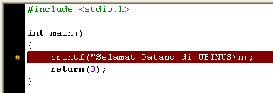
Error Type
Among those Error Types the most difficult to debug is Logical Error.
Example of Compile-Time Error:
Dev-C compiler will give message: In function main missing terminating ” character, syntax error before return

Slide 27
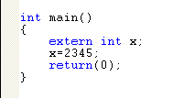

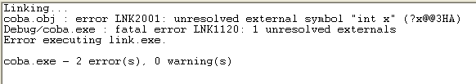
Error Type
Some C compiler merge the compile and link processes, causing in difficulty to distinguish between Compile-Time Error with Link-Time Error
Example of Link-Time Error (Visual C++)

Slide 28
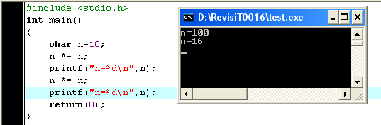
Error Type
Example for Run-Time Error
successfully compiled and linked, but RUN result, causing by overflow (char range max 127)

Slide 29
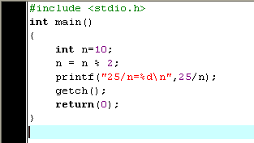
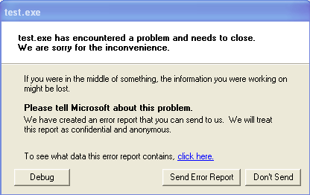
Error Type
Example for Run-Time Error
Error cause:
Division by Zero

Slide 30
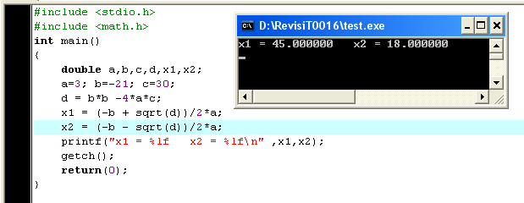
Error Type
Example for Logical-Error
Should be: x1 = 5.00 and x2 = 2.00
Can you find the logic error ??

Slide 31
Exercise
#include <stdio.h>
int main() {
int n;
for(; ;) {
printf(“\n Enter integer : “); scanf(“%d “, &n);
if((n%2) == 0) continue;
else if((n%3) == 0) break;
printf(“\n\t Bottom of loop.”);
}
print(“\n\t Outside of loop.”);
}
What are the output if 7, 4 and 9 entered consecutively?

Slide 32
Exercise
Create a program to input value of student’s IPK (cumulative performance index) and state the grading:
3.5 - 4.0 → Cumlaude
3.0 - 3.4 → Outstanding
2.5 – 2.9 → Very Good
2.0 – 2.4 → Good
less than 2.0 → Poor
Use IF or IF-ELSE

Slide 33
Exercise
Given the following code:
Explain which “if” keyword does the else is pairing with ?
Fix the code to improve readability!
if(n > 0)
if(a > b)
z = a;
else
z = b;

Slide 34
Summary
In an algorithm implementation, an instruction or block of instructions may be executed (or not) with certain predetermined condition, that’s why we use selection
3 types of selection in C:
if
if-else
switch-case

Slide 35
References
Paul Deitel & Harvey Deitel. (2016). C how to program : with an introduction to C++. 08. Pearson Education. Hoboken. ISBN: 9780133976892. Chapter 3 & 4
Choosing between Alternatives: http://docs.roxen.com/pike/7.0/tutorial/statements/conditions.xml
Getting Controls: http://aelinik.free.fr/c/ch10.htm

Slide 36
END

